Slide 1
CTA & ATT Online Legislation
How to use it and how it can help you pass your exams
Nicole Neville
Notes:
1

Slide 2
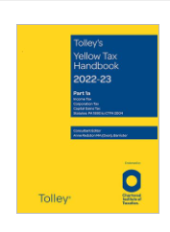
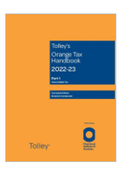
Legislation
For 2023 exams
Tolley’s Yellow Tax Handbooks and Tolley’s Orange Tax Handbooks (2022/23)

Slide 3
Exams in 2023
ATT
Exams are sat remotely
Exam is open book so you can choose to use either printed or online
Consider buying online legislation if you are likely to do a CTA exam in the same calendar year
Tax Pathway
If you choose to sit the CTA awareness paper instead of an ATT paper, this must be sat in an exam centre using online legislation only

Slide 4
Exams in 2023
CTA
Exams are sat in exam centres
You can use online legislation only
Need to bring log-in details with you
ADIT
Exams are sat remotely
You can only use printed version of legislation
You may highlight, underline, sideline, tag pages

Slide 5
Content of the books
Taxes | Tolley (Yellow & Orange)
IT, CT, CGT | Parts 1a-1c – primary legislation Part 2 – secondary legislation
IHT, NIC | Part 3
VAT | Part 1
Stamp Taxes | Part 2
Secondary legislation includes:
Statutory Instruments (SI)
Statements of Practice (SP)
Extra Statutory Concessions (ESC)
Codes of Practice (CoP)

Slide 6
Parts 1a-1c
Primary Legislation
Income Tax, Corporation Tax and CGT
Chronological order
Consolidation process:
6 main Acts for Income Tax and Corporation Tax
1 for Capital Gains Tax
1 for Capital Allowances

Slide 7
Primary legislation
TAX | ACT | VOLUME
Capital Gains | TCGA 1992 | 1A
Capital Allowances | CAA 2001 | 1A
Income Tax | ITEPA 2003 ITTOIA 2005 ITA 2007 | 1A 1B 1B
Corporation Tax | CTA 2009 TIOPA 2010 CTA 2010 | 1B 1B 1C

Slide 8
Proforma Income Tax computation
IT Comp 2022/23 | Non-savings income |  | Savings income |  | Dividends
Employment income | x
Trading income | x
Property income | x
Interest |  |  | x
Dividends |  |  |  |  | x
Total Income | x |  | x |  | x
Less: Deductible payments | (x)
Net Income | x |  | x |  | x
Personal Allowance | (x)
Taxable Income | x |  | x |  | x

Slide 9
Proforma Income Tax computation cont.
IT on Taxable Income | £
IT on non-savings income 20% / 40% / 45% | x
IT on savings income 0% / 20% / 40% / 45% | x
IT on dividends 0% / 8.75% / 33.75% / 39.35% | x
 | x
Less: Tax reducers
VCT, EIS, SEIS, SIT | (x)
MCA, MA | (x)
IT Liability | x
Less: IT deducted at source | (x)
IT payable / (repayable) | x / (x)

Slide 10
Income tax
ITEPA 2003 = Income Tax (Earnings and Pensions) Act 2003
All rules of employment income eg benefits, termination payments, share schemes
ITTOIA 2005 = Income Tax (Trading and Other Income) Act 2005
Includes: rules on adjustment to profit, basis periods, partnerships, property income, furnished holiday lets and trust income
ITA 2007 = Income Tax Act 2007
Everything else to do with income tax but not specifically related to a particular source of income, eg deductible payments, personal allowance, income tax reducers

Slide 11
Primary legislation
TAX | ACT | VOLUME
Capital Gains | TCGA 1992 | 1A
Capital Allowances | CAA 2001 | 1A
Income Tax | ITEPA 2003 ITTOIA 2005 ITA 2007 | 1A 1B 1B
Corporation Tax | CTA 2009 TIOPA 2010 CTA 2010 | 1B 1B 1C

Slide 12
Proforma Corporation Tax computation
CT Comp for the x months ended... |  | £ | £
Trading income
 | Adjusted profits | x
 | Less: Capital allowances | (x)
 |  |  | x
Non-trade loan relationship income |  |  | x
Property income |  |  | x
Non-trade IFA income |  |  | x
Net capital gains |  |  | x
Total Profits |  |  | x
Less: Qualifying charitable donations |  |  | (x)
TTP |  |  | x
CT @ appropriate rate | x

Slide 13
Primary legislation
TAX | ACT | VOLUME
Capital Gains | TCGA 1992 | 1A
Capital Allowances | CAA 2001 | 1A
Income Tax | ITEPA 2003 ITTOIA 2005 ITA 2007 | 1A 1B 1B
Corporation Tax | CTA 2009 TIOPA 2010 CTA 2010 | 1B 1B 1C

Slide 14
Corporation tax
CTA 2009 = Corporation Tax Act 2009
Anything impacting on the total profit of the company eg adjustment to profits, loan relationships, intangible fixed assets, research and development
CTA 2010 = Corporation Tax Act 2010
Everything else to do with corporation tax but not specifically related to a particular source of income eg calculation of corporation tax liability, losses, groups, close companies, purchase of own shares
TIOPA 2010 (Vol 1b) = Taxation (International and Other Provisions) Act 2010
Eg controlled foreign companies and transfer pricing

Slide 15
Using the digital library – logging in
Log in as follows:
The url is: https://lexisdl.com/library/taxleg/
You will then be prompted for your user id and password
Note: If you sign back out and can’t find the original url, input the library code taxleg and then your login details to get back in
You can also download the LexisNexis Digital Library App:
You will be prompted for a library code: taxleg
Then your log in details: email address and password
Note: the App can be downloaded to Windows Desktop, Android or iOS but not to a Mac Desktop

Slide 16
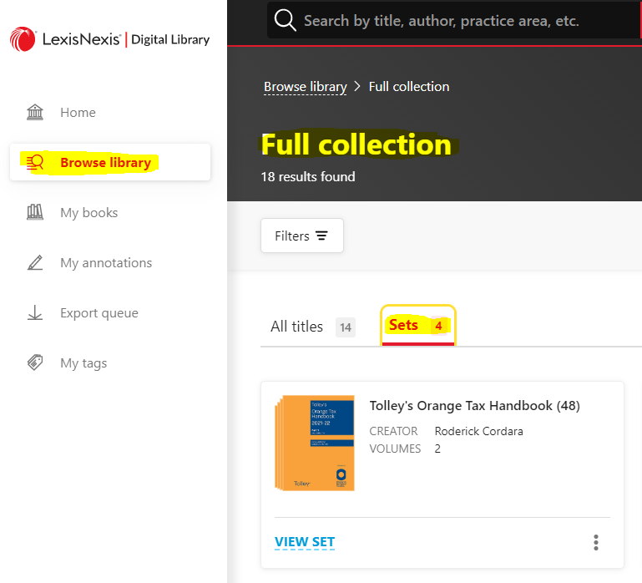
Using the digital library – getting started
Add the volumes of legislation you need to your account
Browse library – gives you choice of books
Scroll to the bottom and click on View Full Collection
Then click on Sets (top of page)
The 2022/23 edition of Yellow is edition 63 and Orange is edition 49
Click on View Set to open the volumes in that set
Click on READ, then book appears on Home page and in My books

Slide 17
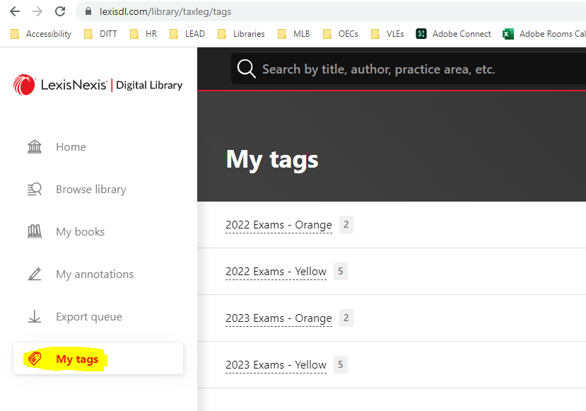
Using the digital library– getting started
Tagging volumes
Click on the cover of the book
Underneath the red Read button click on Add new tag
If you use the same tag for multiple books they will be grouped together and can be accessed via My tags from the tabs on the left hand side

Slide 18
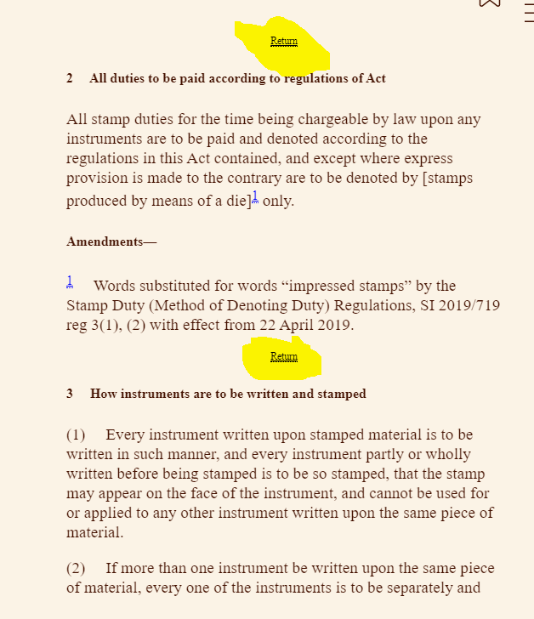
Using the digital library– reading the legislation
Reading the legislation
Click on the book you want
Click on the red Read button
To turn the pages:
Put cursor on right of screen to turn pages forwards
Put cursor on left of screen to turn pages backwards
Or use the left and right arrow keys to turn the pages
In the App use your finger to scroll
Use Return to get back to where you were previously

Slide 19
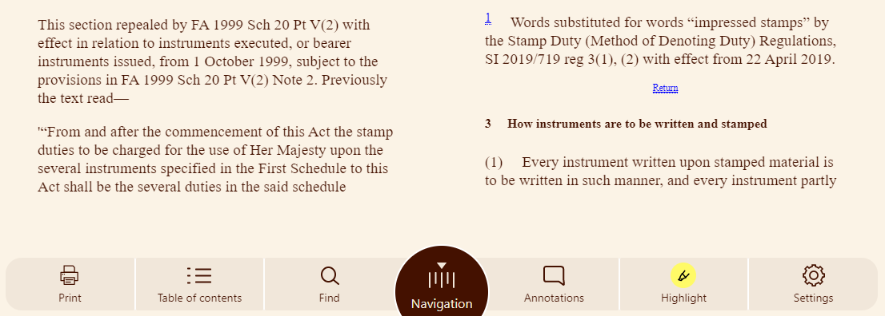
Using the digital library
Use Table of Contents to find the Act you are looking for
Use Settings for accessibility functionality, eg to change lighting, font size, layout
Click Highlight to activate highlighter pen.
Choose highlighter colour
Click Annotations to see all your highlights
Can filter by colour
Navigation, bookmarks
Not so useful
Use Find as an index

Slide 20
Using the digital library
Tips on highlighting
To start with: highlight contents page of the Act
Then: highlight rules / conditions / limits in the section
Think about use of different colours
eg for different topics
eg as a ‘sign post’

Slide 21
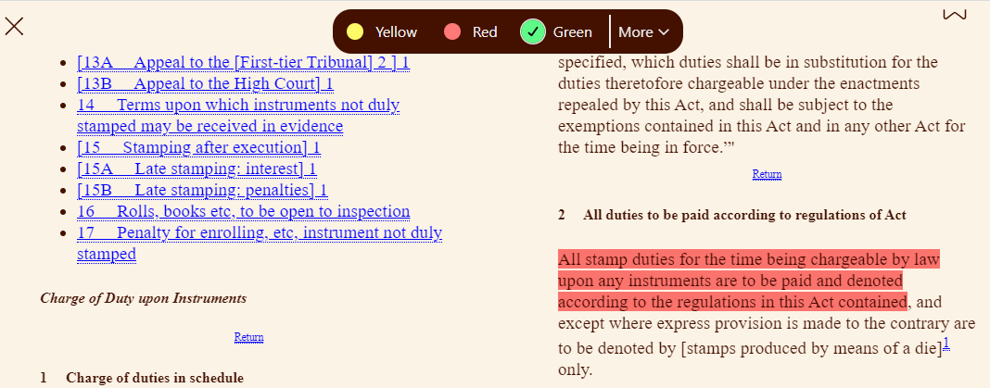
Using the digital library
Tips on highlighting
In OverDrive – on your keyboard press +
This opens the highlighting tool, to highlight content just select the content and it will automatically add the colour of your choice:
Shift
H

Slide 22
Using the digital library
Keyboard commands
For more keyboard commands click on the three horizontal lines in the top right of the screen when you have any book open:

Slide 23
Capital allowances
Capital Allowances Act (CAA) 2001
Very useful with definition of ‘plant’
Section 21 – what is a building so not plant
Section 22 – list of structures which are not plant
Section 23 – list of items that look like building / structure but are plant
Most of items in Section 23 come from case law

Slide 24
CAA 2001, Part 2, Ch 3 Qualifying expenditure
Buildings, structures and land
21 Buildings
(1) For the purposes of this Act, expenditure on the provision of plant or machinery does not include expenditure on the provision of a building.
(2) The provision of a building includes its construction or acquisition.
(3) In this section, “building” includes an asset which— (a) is incorporated in the building, (b) although not incorporated in the building (whether because the asset is moveable or for any other reason), is in the building and is of a kind normally incorporated in a building, or (c) is in, or connected with, the building and is in list A.
LIST A Assets treated as buildings
1. Walls, floors, ceilings, doors, gates, shutters, windows and stairs.
2. Mains services, and systems, for water, electricity and gas.
3. Waste disposal systems.
4. Sewerage and drainage systems.
5. Shafts or other structures in which lifts, hoists, escalators and moving walkways are installed.
6. Fire safety systems.
(4) This section is subject to section 23.

Slide 25
CAA 2001, Part 2, Ch 3 Qualifying expenditure
23 Expenditure unaffected by sections 21 and 22
(1) Sections 21 and 22 do not apply to any expenditure to which any of the provisions listed in subsection (2) applies.
(2) The provisions are—
section 28 (thermal insulation of . . . buildings); section 33 (personal security); section 33A (integral features); section 71 (software and rights to software); section [143 of ITTOIA 2005 or section] 40D of F(No 2)A 1992 (election relating to tax treatment of films expenditure).
(3) Sections 21 and 22 also do not affect the question whether expenditure on any item described in list C is, for the purposes of this Act, expenditure on the provision of plant or machinery.
(4) But items 1 to 16 of list C do not include any asset whose principal purpose is to insulate or enclose the interior of a building or to provide an interior wall, floor or ceiling which (in each case) is intended to remain permanently in place.

Slide 26
CAA 2001, Part 2, Ch 3 Qualifying expenditure
LIST C EXPENDITURE UNAFFECTED BY SECTIONS 21 AND 22
1. Machinery (including devices for providing motive power) not within any other item in this list.
2. . . . Gas and sewerage systems provided mainly— (a) to meet the particular requirements of the qualifying activity, or (b) to serve particular plant or machinery used for the purposes of the qualifying activity.
3. . . .
4. Manufacturing or processing equipment; storage equipment (including cold rooms); display equipment; and counters, checkouts and similar equipment.
5. Cookers, washing machines, dishwashers, refrigerators and similar equipment; washbasins, sinks, baths, showers, sanitary ware and similar equipment; and furniture and furnishings.
6. [Hoists].
7. Sound insulation provided mainly to meet the particular requirements of the qualifying activity.
8. Computer, telecommunication and surveillance systems (including their wiring or other links).
9. Refrigeration or cooling equipment.
10. Fire alarm systems; sprinkler and other equipment for extinguishing or containing fires.
11. Burglar alarm systems.
12. Strong rooms in bank or building society premises; safes.
13. Partition walls, where moveable and intended to be moved in the course of the qualifying activity.
14. Decorative assets provided for the enjoyment of the public in hotel, restaurant or similar trades.
15. Advertising hoardings; signs, displays and similar assets.

Slide 27
Orange Book 1
VATA 1994
Sch 7A Reduced rate supplies
Sch 8 VATA 1994 Zero-rated supplies
Sch 9 VATA 1994 Exempt supplies
SI 1995/2518
Reg 14 Contents of a VAT invoice
Reg 16 Contents of retailer's invoice
Regs 49-60 Annual Accounting, Flat Rate Scheme, Cash Accounting
Regs 99-109 Partial Exemption
Regs 112-116 Capital Goods Scheme
Notice 741A International services

Slide 28
Part 2 – the hidden gems
Statements of Practice (SPs)
Pre 1978
D12 – Partnership CGT
Post 1978
2/82 – Purchase of own shares
1/90 – Co residence
10/91 – Major change in nature or conduct of trade
5/96 – PSA

Slide 29
Part 2 – The hidden gems
Codes of Practice (COPs)
CC/FS7a Penalties – inaccuracies
CC/FS11 Penalties – failure to notify
CC/FS18a Penalties – late filing
Miscellaneous non-statutory material
RDR 1, 3 & 4 ~ Residence, SRT etc
IR35 Revised Guidance ~ PSCs
Guidelines on meaning of R&D for tax purposes

Slide 30
Examiners Comments: CTA Advanced technical
Since the focus of this paper is on technical skills and no question will require a document for a client, candidates will never be penalised for referring to legislation or case law. We will not normally penalise candidates who describe the legislation without giving the reference. Similarly, candidates referring to a case by description rather than name (where they have forgotten the name) will not normally be penalised. Marks will therefore primarily be for the underlying technical skills.
As at present, there may be some questions where we specifically ask for an answer by reference to legislation or case law and in such cases candidates who do not provide such references will miss out on some marks.

Slide 31
Beware
You still have to
understand it
The legislation gives you the rules
– it won’t give you the answer or the advice

